Slide 1
Workshop: ISS image analysis basics
170614
Xiaoyan

Slide 2
I. Basic Morphological Operations

Slide 3
Erosion & dilation
Opening
Closing
Tophat

Slide 4
Edge detection
Gradient detection
Spatial 2nd derivatives

Slide 5
Segmentation

Slide 6
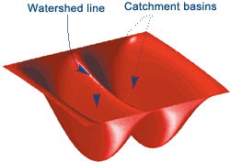
De-clumping
Watershed
Over-segmentation
Forced seeds

Slide 7
II. ISS Cellprofiler pipeline

Slide 8
Images
All blobs have anchor stain
All blobs are dual stained in one round
Shift (and rotation) between rounds

Slide 9
Problem statement
What is a seq amplicon (RCP)?
Registration (alignment)
How to determine base of a blob?
Additional things to consider
Parallelization
Scalability

Slide 10
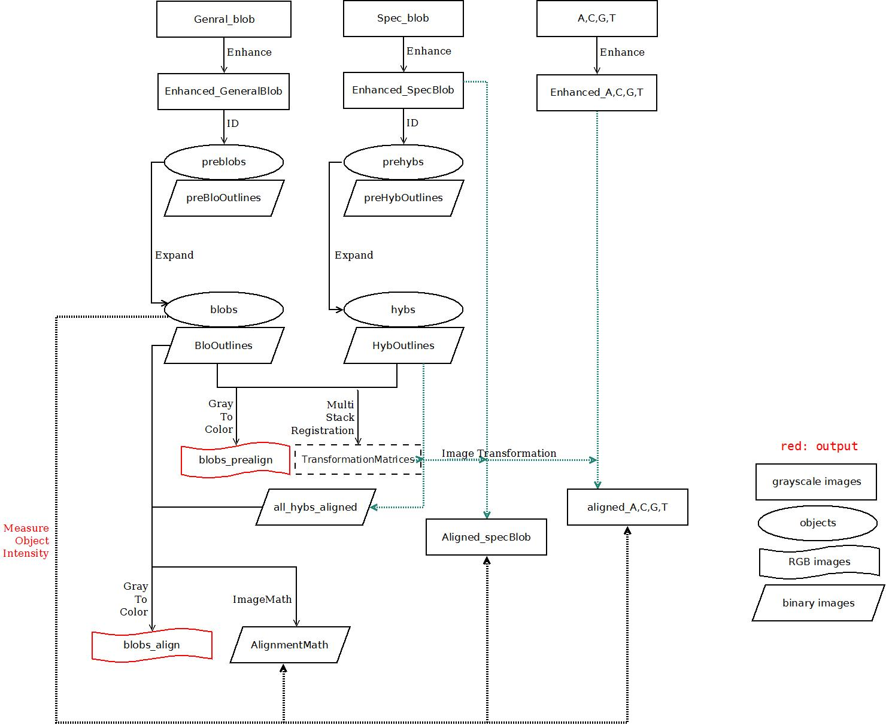
Pipeline diagram

Slide 11
III. Cellprofiler pipeline troubleshooting

Slide 12
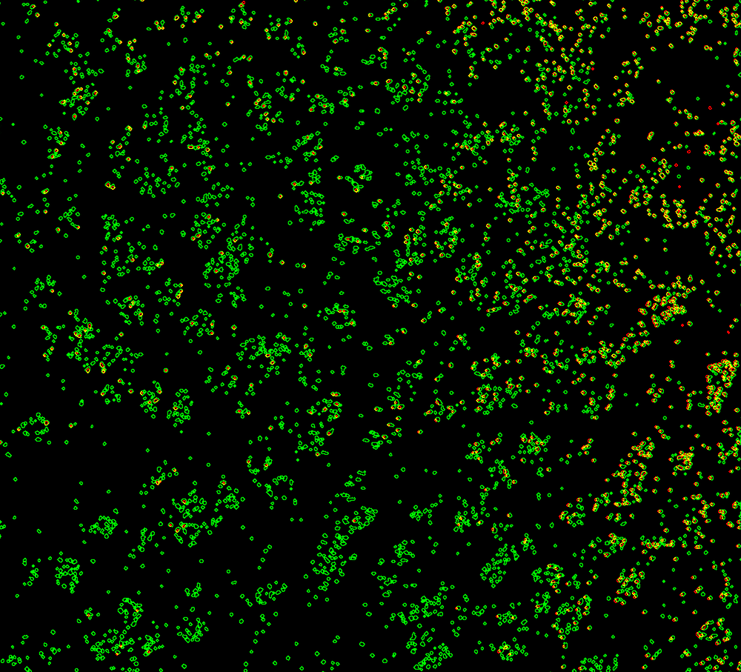
Reference blob identification
More identified in non-reference round(s)
Quick fix: change reference round

Slide 13
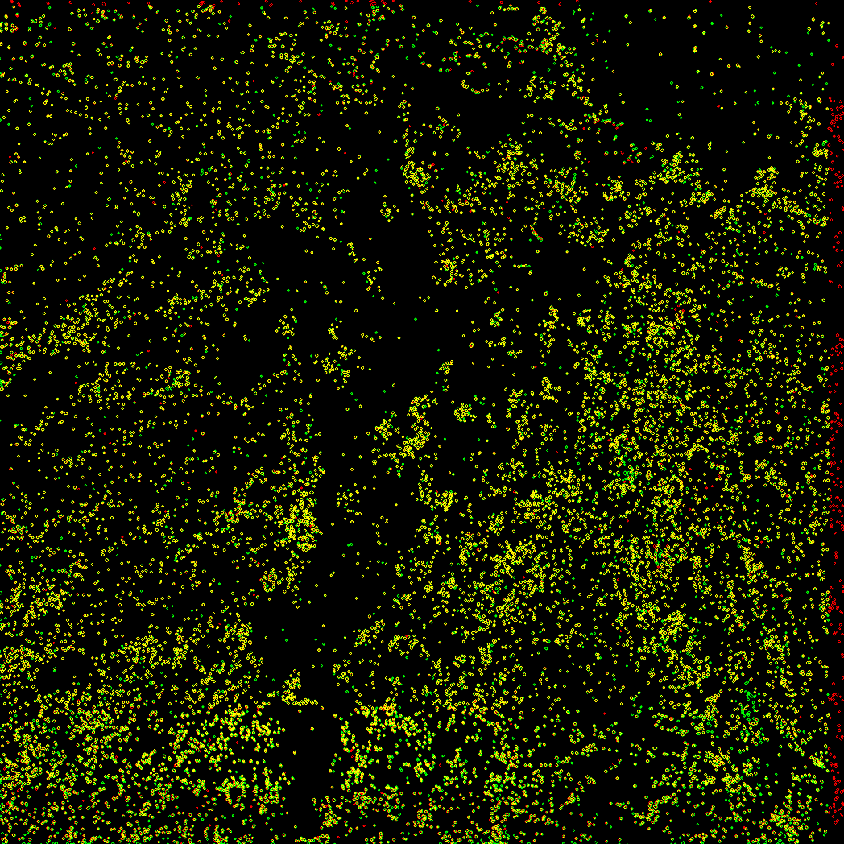
Edge loss?
In most cases, I would say live with it…
In severe cases, can tile with buffer and discard anything around the edge

Slide 14
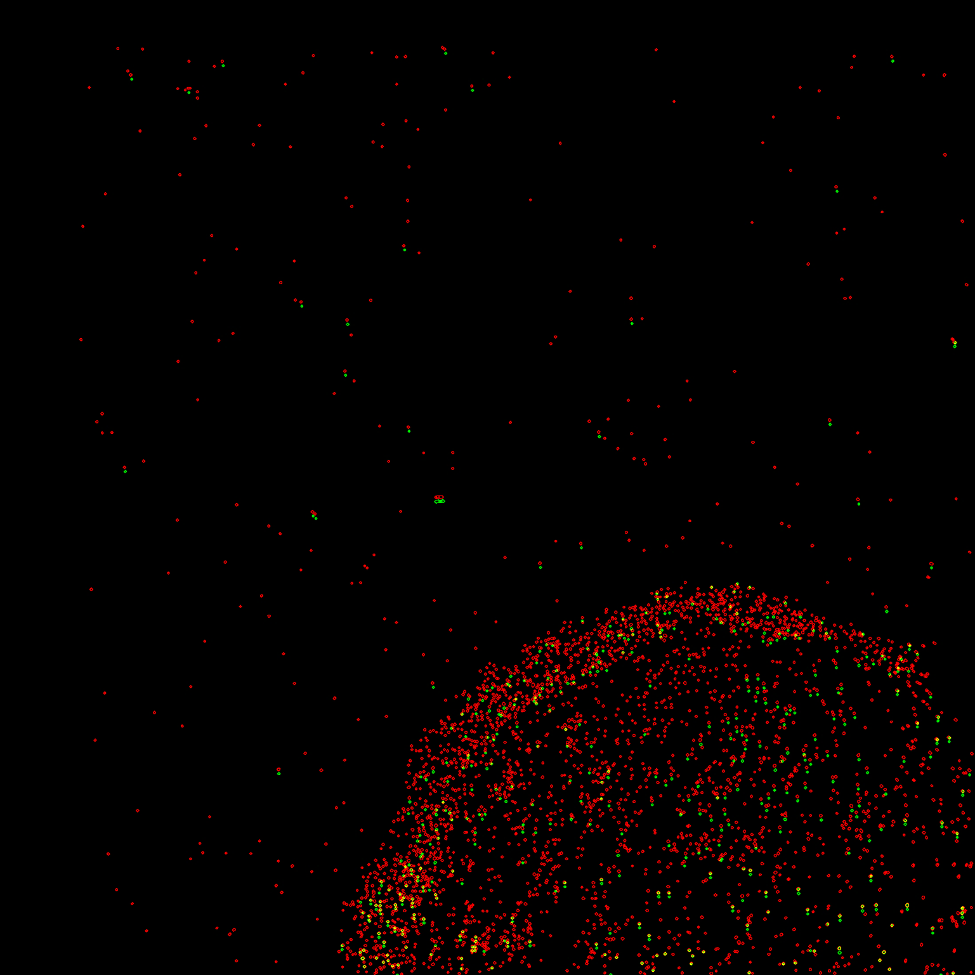
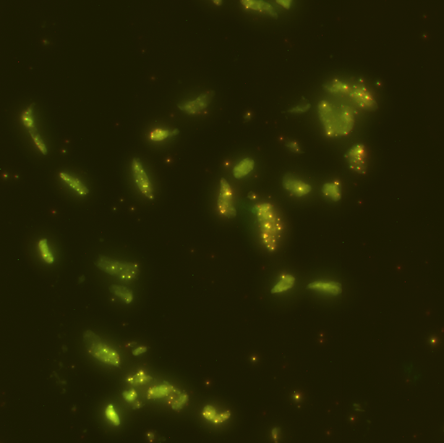
Alignment failure - too few blobs (mutual info)?
Try align based on DAPI (or even autofluorescence) and expand objects
If there is general stain,
compose an image of DAPI + anchor with different weights

Slide 15
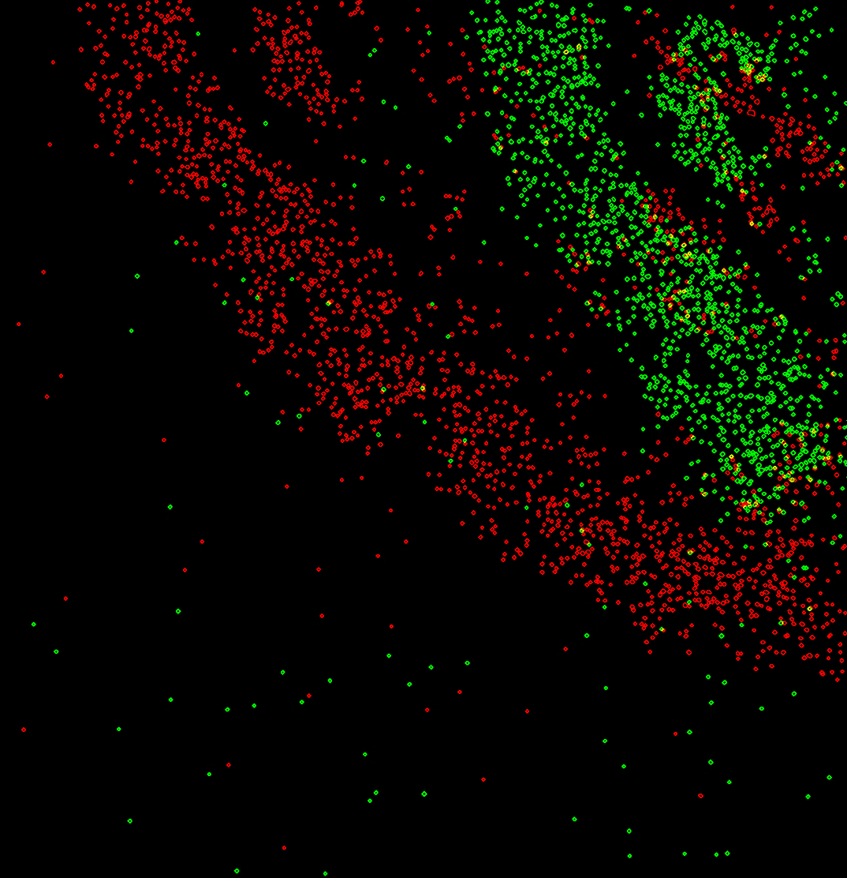
Alignment failure - rotation
Pre-alignment helps!

Slide 16
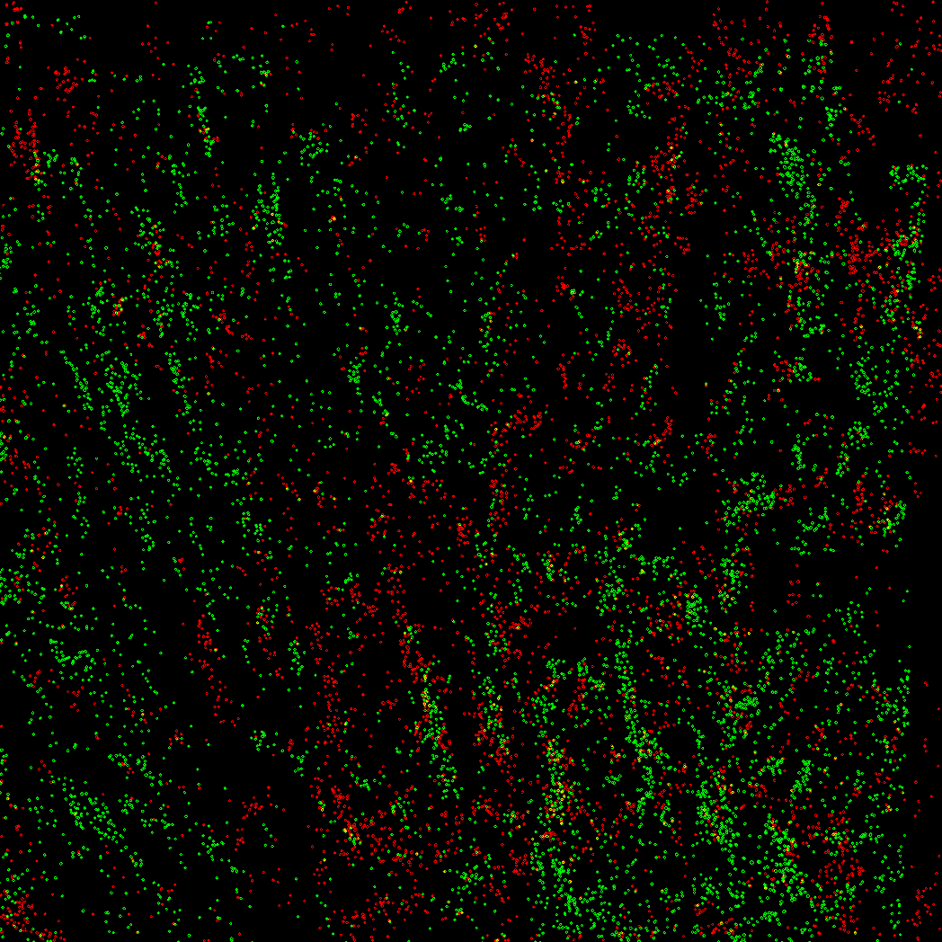
Alignment failure – too much shift
You can also export only ROI from ZEN
Or do manual pre-alignment if you think that’s faster

Slide 17
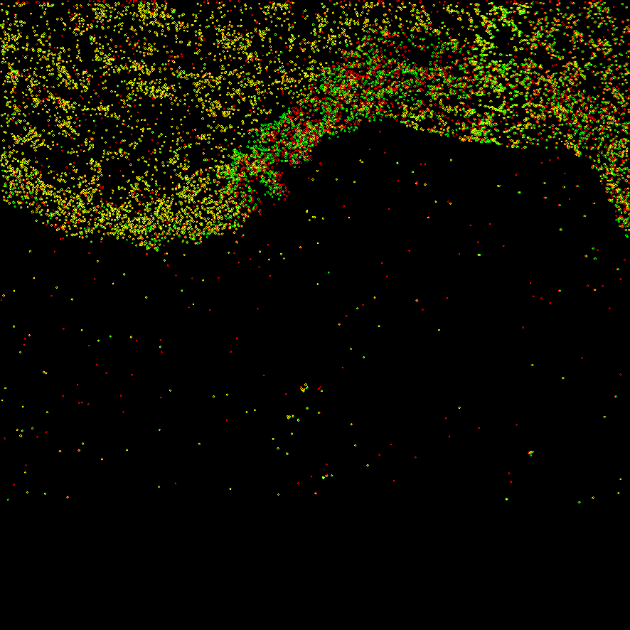
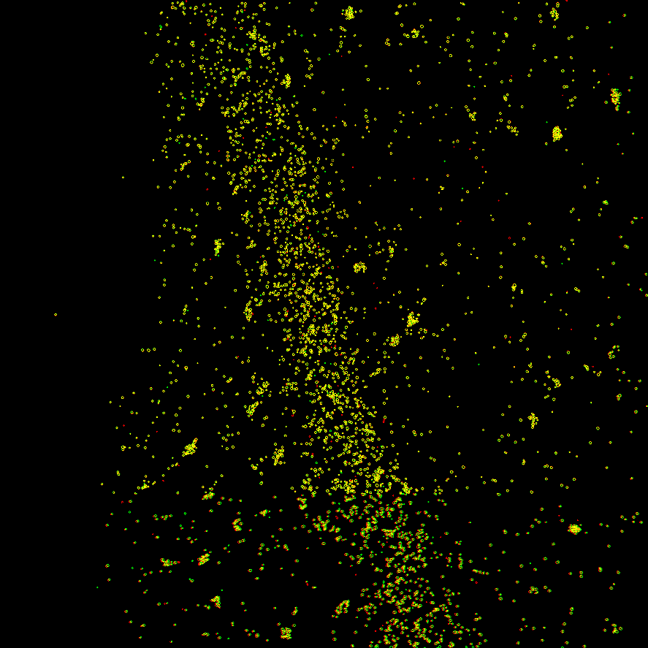
Alignment failure – non-rigid/non-linear
Tissue deformation?
You have to accept imperfection...
Can expand objects a bit more
Stitching?

Slide 18
Base-calling

Slide 19
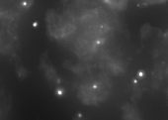
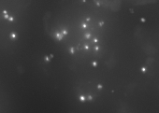
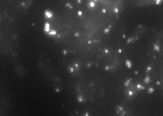
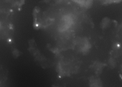
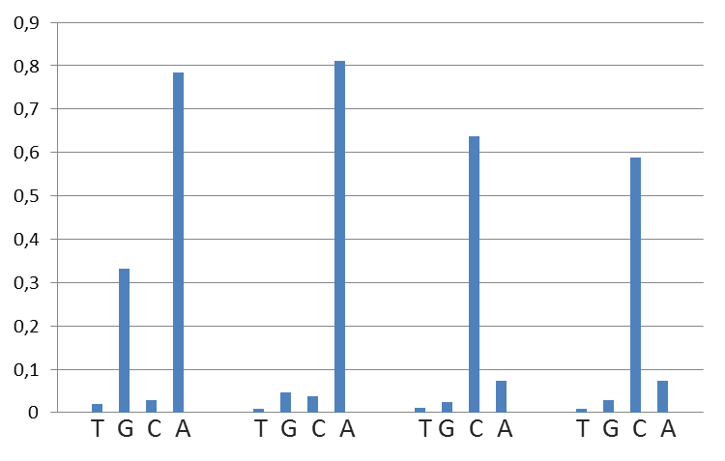
Concept
A
C
G
T
Sequencing cycle: 1 2 3 4
Assigned base: A A C C
AACC ⬄ EPCAM

Slide 20
In practice

Slide 21
Too many unexpected reads
Always check raw images
Any obvious pattern?
Autofluorescence correction

Slide 22
IV. Cell segmentation and image-based single cell analysis

Slide 23
Cell segmentation
Starting point: DAPI stain
Purpose?
Cell counting
Blob-cell relation (independent of ISS pipeline)
*cell tracking
Identify the problem(s)
Boundary detection critical? Is estimation OK?
Too dense cells, no intensity peaks and valleys
Funny nuclear morphology
Polynuclear, e.g. muscle cells
Heterogeneous sample
Use morphological operations efficiently

Slide 24
Object segmentation
Parent object labeling

Slide 25
Edge correction
Not practical to run on whole image => have to deal with edge effect

Slide 26
V. NEW MATLAB pipeline

Slide 27
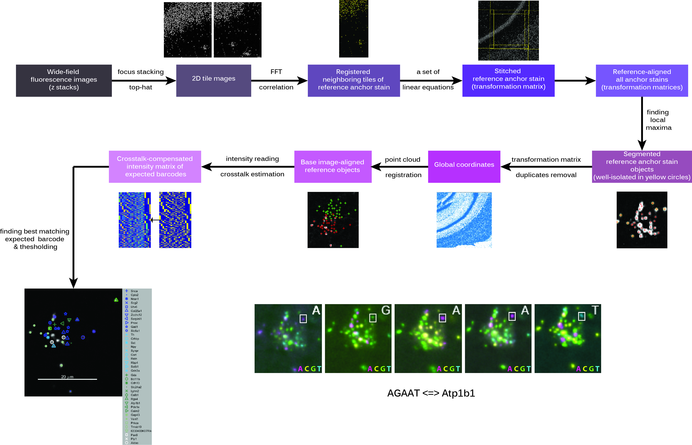

Slide 28
VI. Alternative methods

Slide 29
FISH-quant
Similar maxima finding
Averaging spots
FISSEQ
Pixel calling
Seq-FISH
Individual color segmentation

